Slide 1

Wet Lab Accelerator
Visual Design in Automated Biological Cloud Labs
Maxwell Bates
Bio-Nano : Autodesk Research
Notes:
overview
assume little biology background
overview of research, problems, current developments
work we’re doing + demo WLA

Slide 2
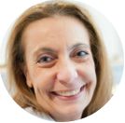

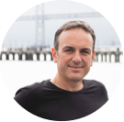
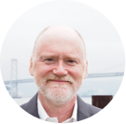
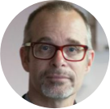

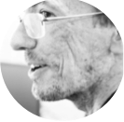
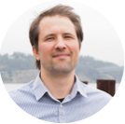
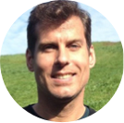
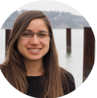

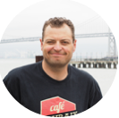


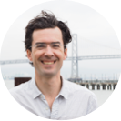



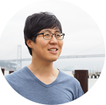
Bio-Nano
Notes:
- Group in autodesk research - with developers & researchers
- not curing cancer - leverage software to do development in the field, particularly internal research
- biology is an exploding field - massive investment
- powerful systems, years of evolution -> master of design
CLICK
- while faces are up, highlight people working on project i’ll be focusing on

Slide 3
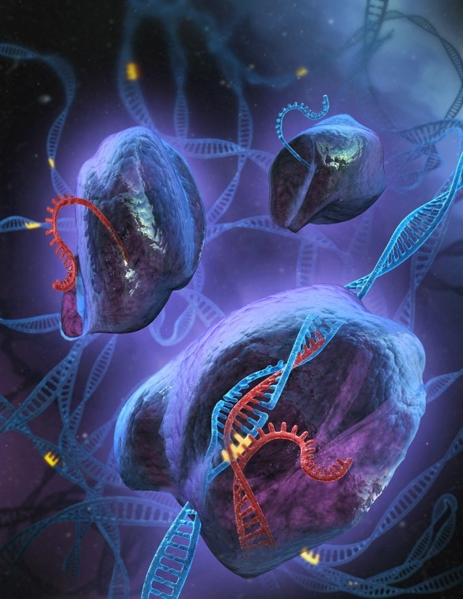

Malte Tinnus, Autodesk
Notes:
internal research: drug discovery, DNA origami, bioprinting, biological platforms…
CRISPR - specific gene editing
synthetic viruses

Slide 4
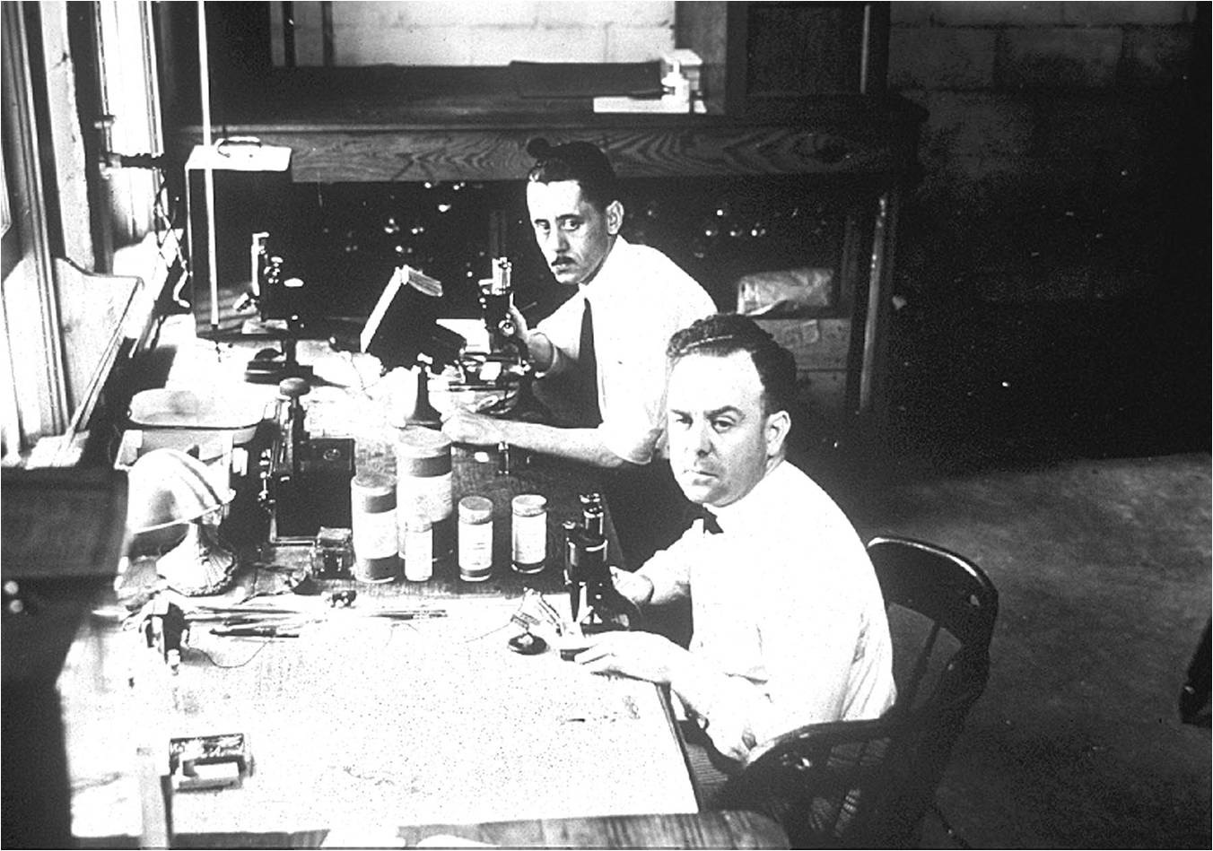
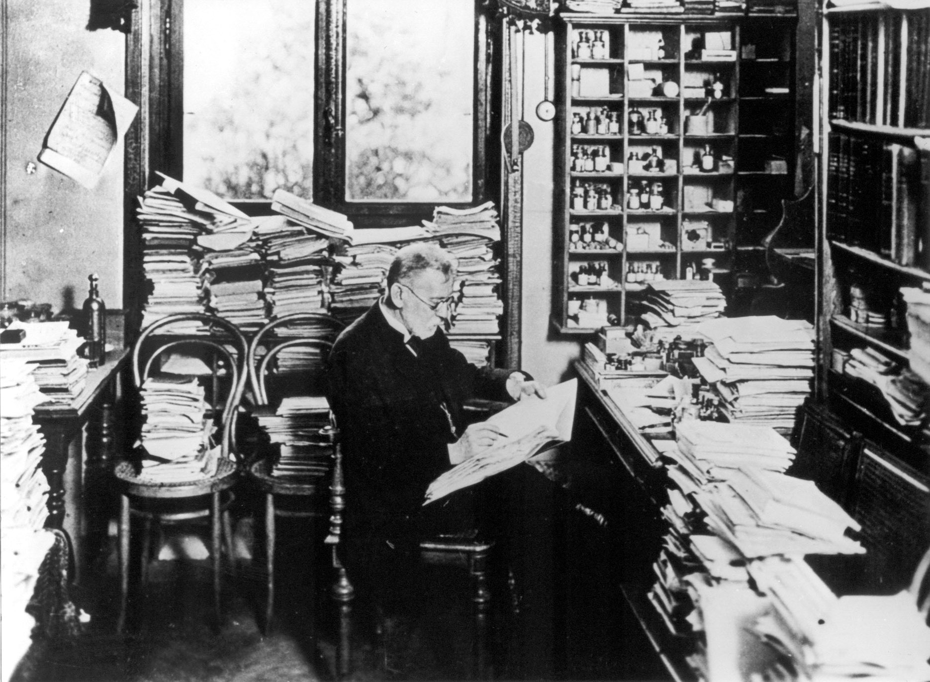
Florida Plant University
Wikimedia
Notes:
Transition from pure research to engineering
- pure research - grounded in observation
- E.g. look at visualization -> used for understanding
- Experiment because we are bad at predicting, especially novel systems
Back then, experimenting sucked. Consider what a typical day in a traditional biotech research lab looks like. Researchers sit at the bench, furiously hand write detailed parameters of their experiment (temperature, pH, oxygen content, and the like), tediously move small volumes in and out of test tubes hundreds of times, and track labels for dozens or hundreds (or more) of samples.

Slide 5
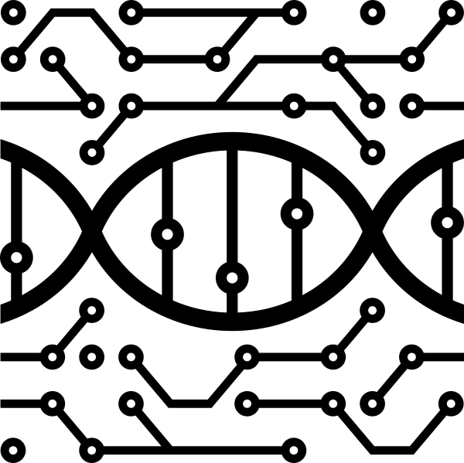
1972
Synthetic Gene
1990s
Sequencing
Advancements
2002
Synthetic Virus
2010
Synthetic
Bacterium
1981
Transgenic Animals
2000
Engineered
Bacterial System
2007
Synthetic
Bacterial
Genome
2012
CRISPR in
human cells
Notes:
Synthetic Biology timeline
1972 - yeast tRNA
1981 - mice
2002 - polio virus
2012 CRISPR came out, first time have off the shelf system for specific DNA delivery (give you a sense where the field is)
- over time, also see increasing number of authors on papers, particularly as we further specialize
biological debugging - hard

Slide 6
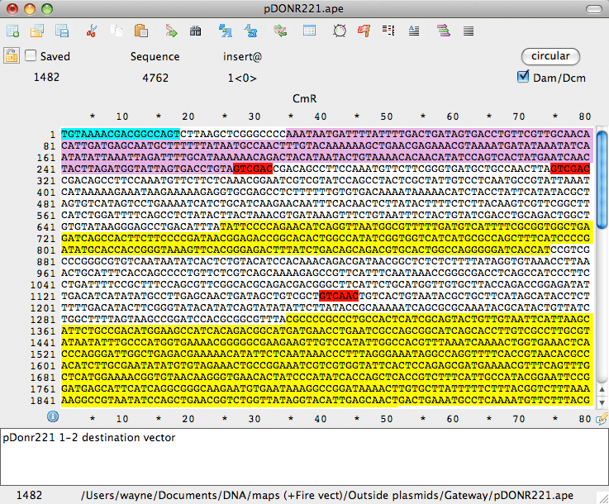
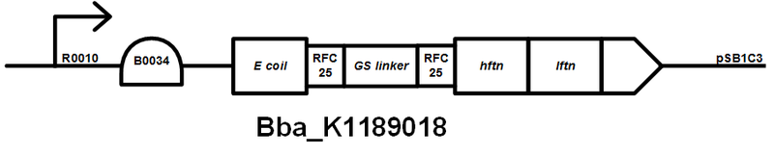
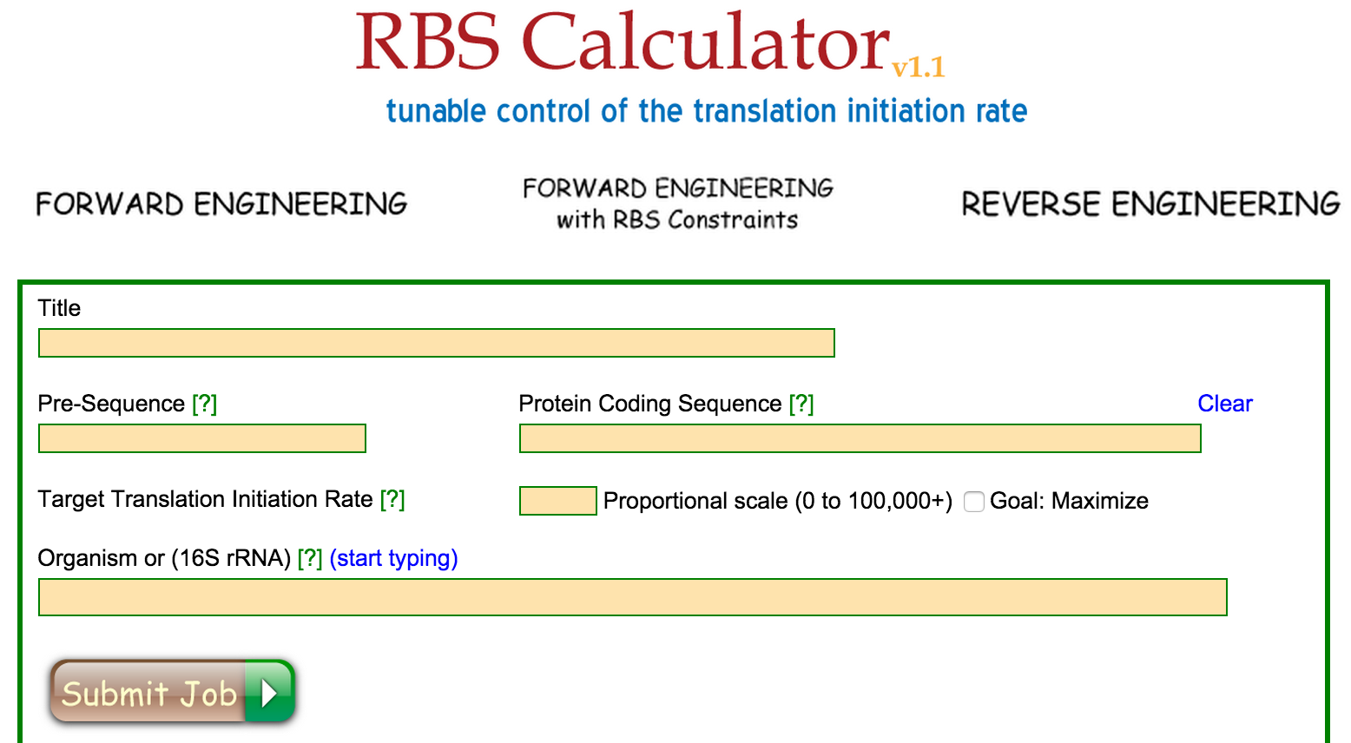
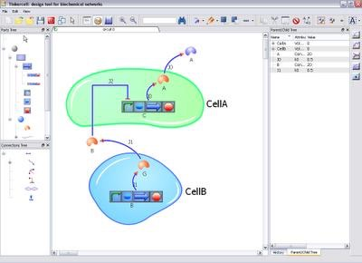
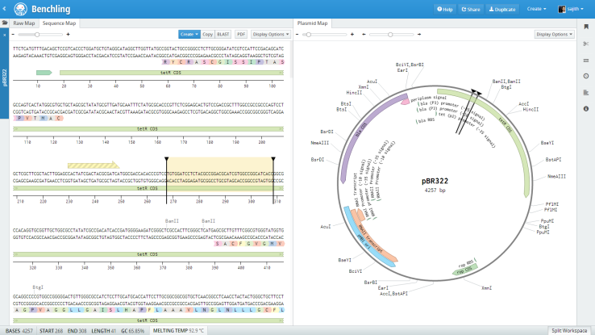
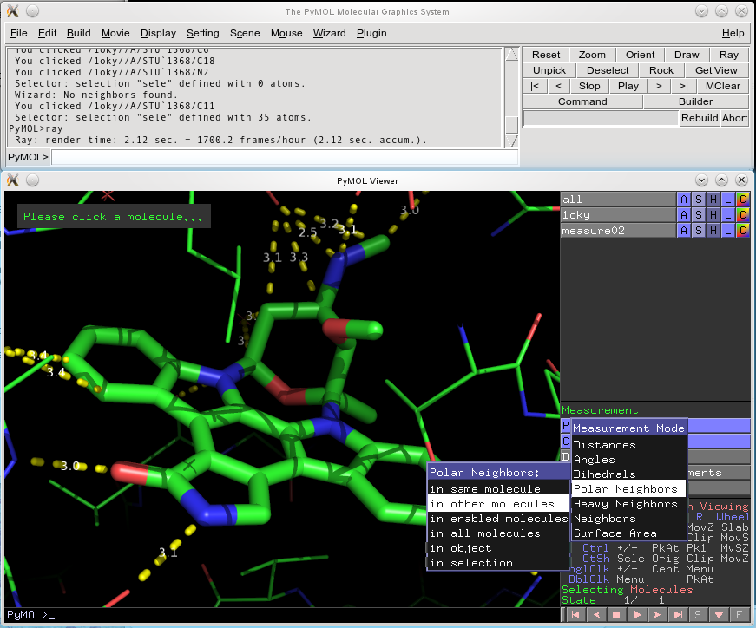
Why Biology?
Notes:
Where does autodesk fit in? look at tools today.
Lacks solid CAD/CAM software - these are the primary visual abstractions today
Few tools integrated (Benchling [shown] probably best software out there - but many scientists have problems with it)
not so simple as designing good looking software.
2 big questions in biological design
- Nanoscale design is hard because not creating what you see
- Visualization aids understanding, but the functional representation is difficult, functional design even harder
Football analogy of viruses
beyond visualization, other problems in research + biological design

Slide 7
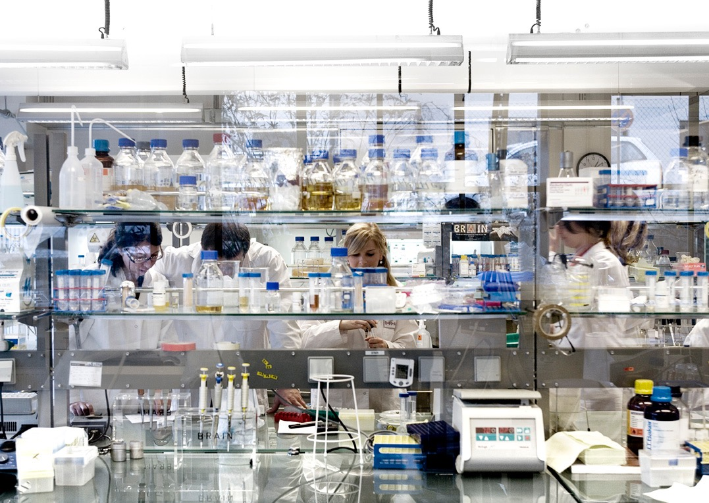
Biological Research
Problems Today
Time
Humans
Reproducibility crisis
Publication
Inconsistent data schemas
Ordering
Simulation
Notes:
Skip forward 100 years, any its basically the same. Besides color pictures, now we have cool glasses, lot more plastic…. but not a lot has changed
DBTL in biology is slow + cumbersome
Iteration time dependent on running experiments
Spend 70-90% of time in the lab doing experiments

Slide 8
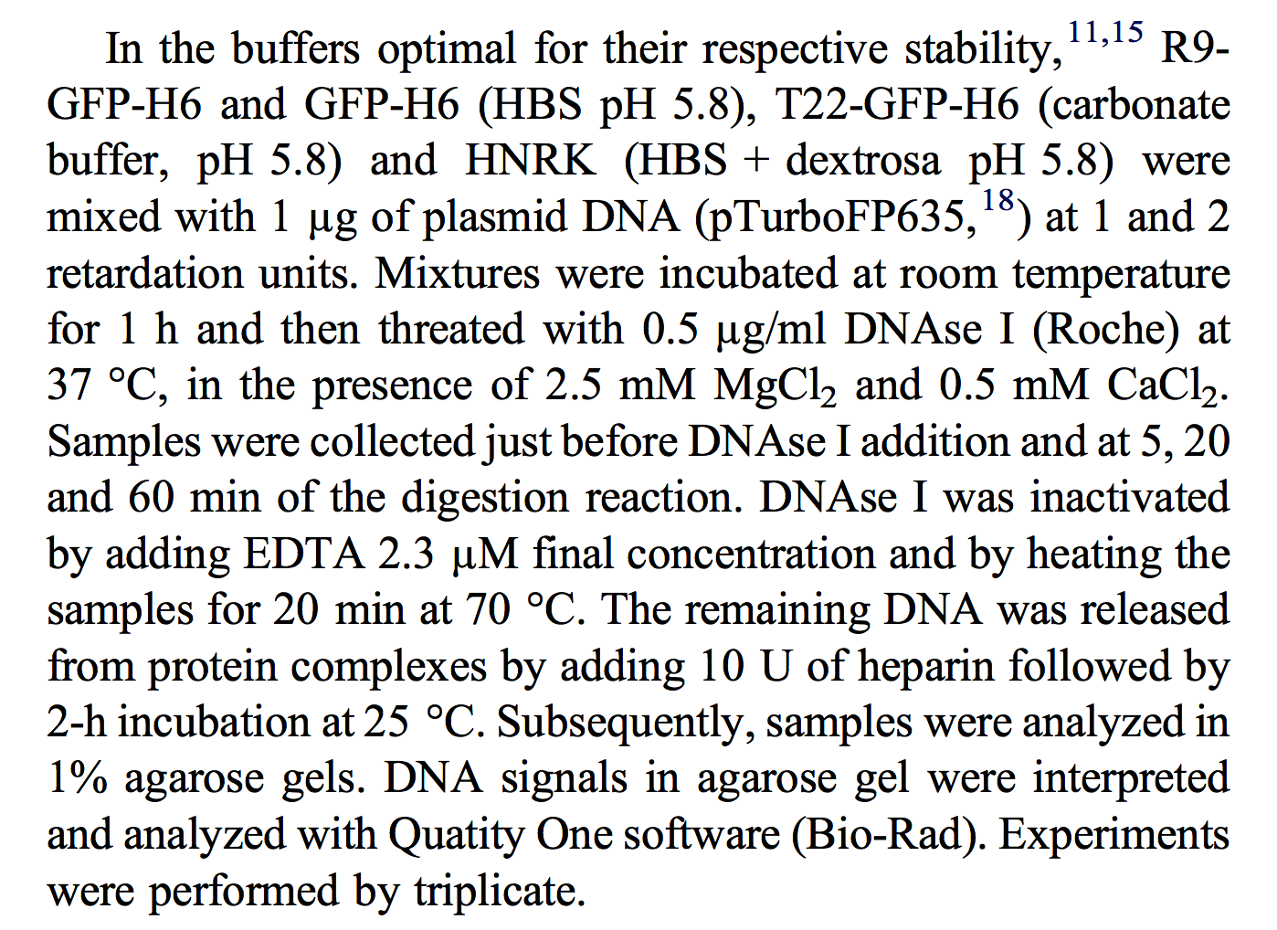
Biological Research
Problems Today
Time
Humans
Reproducibility crisis
Publication
Inconsistent data schemas
Ordering
Simulation
Notes:
Bayer (2011) could only reproduce 25% of studies, Amyris (2012) 11%
Journals don’t want to publish repeat experiments
Ordering complicated - hard to share samples, sometimes have to call distributors, etc.
- Finicky nature of biology (in our current limited understanding)
- humans simply aren't the best way to conduct biotech research.

Slide 9
D
B
T
L
Notes:
within course of an experiment,
hypothesis / design intent
design experiment, run it,
sometimes use it to inform next experiment, but often fairly linear
example process in genetic engineering
select target
design genetic circuit
assemble in lab, or automated, liquid handling, QA/QC
test through spectrophotometry, mass spec, etc.
learn to inform design

Slide 10
D
L
B
T
Notes:
Disconnect between ideas of manufacturing quality and how science is performed
CLICK
design - goal is move toward predictive models
requires better understanding + data

Slide 11
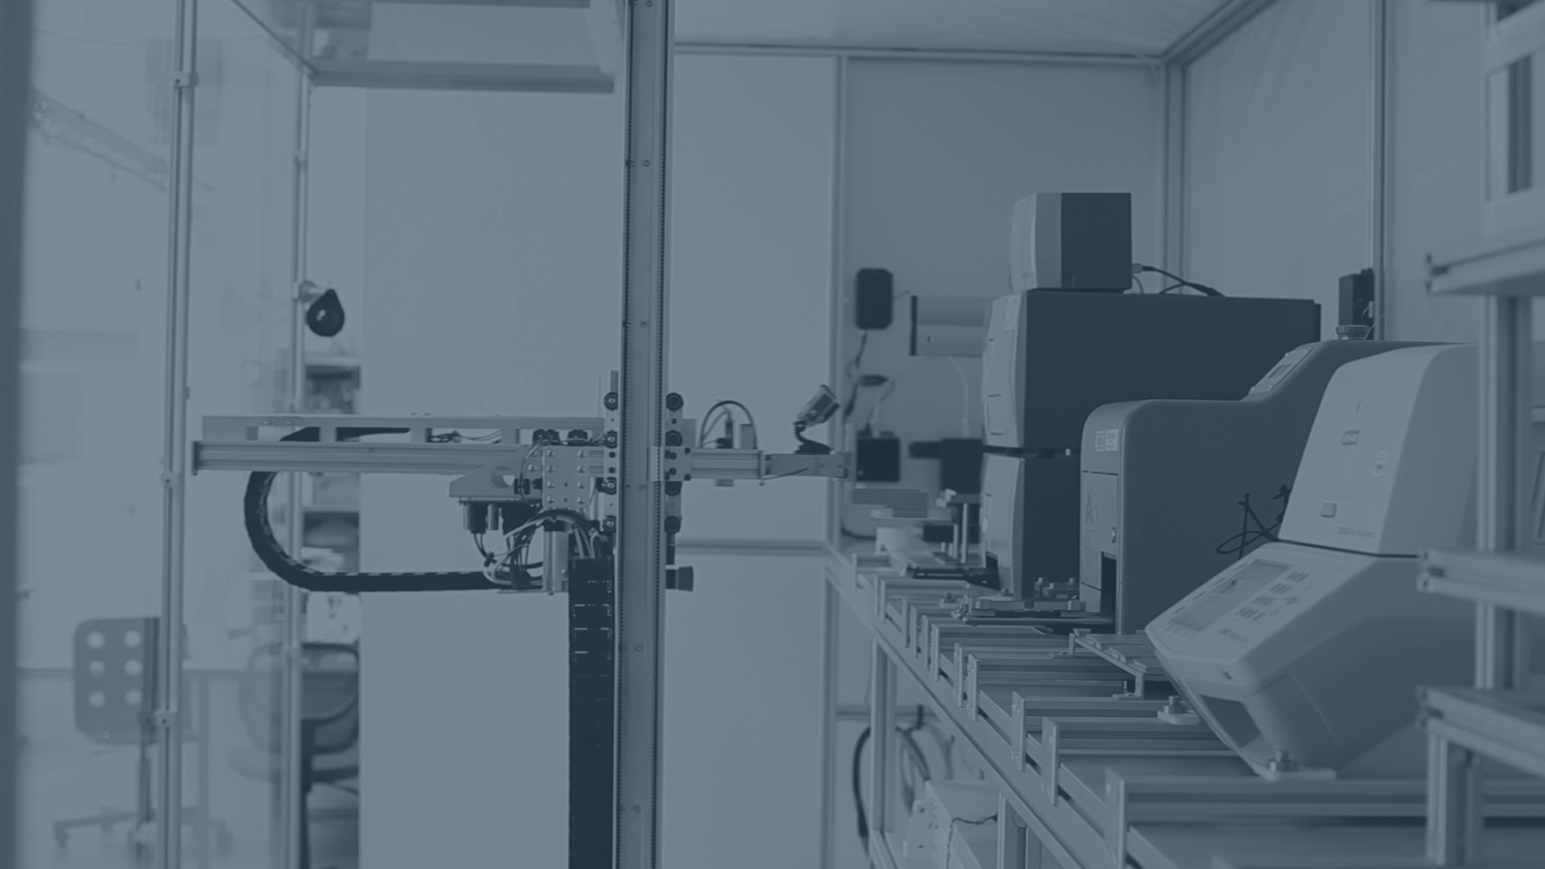
Transcriptic
Notes:
Solution to many of these problems… automated, cloud labs!
Define Protocol
Perform discrete, repeatable operations
Interact via machine-code
Repeatable
Cheaper, don’t require infrastructure - in the hands of the masses
desktop vs. cloud systems
address QC + problems standardizing
We're nearing the point where anyone with a little biology knowledge, a laptop, and an Internet connection can create a custom organism or biology-derived product from a coffee shop. In fact, it's already possible today. But doesn’t have design software.

Slide 12







Notes:
Transcriptic - currently only one available. only one that is all robots
Autoprotocol - open source language, but implementation non-trivial. but only available language. Part of NIST group Automation and Protocol Interoperability
Desktop vs Cloud Labs (integrated)

Slide 13
Our Projects
Wet Lab Accelerator
Synthetic Virology / Genome Editing
Molecule Viewer
Biological Visualization / Design
Platform
Scientific Collaboration + Sharing
Notes:
Our software
- Support internal research
- Building biological platforms
- Support standardization + sharing
Toward visual design of biology
Viewer e.g. DNA Origami

Slide 14
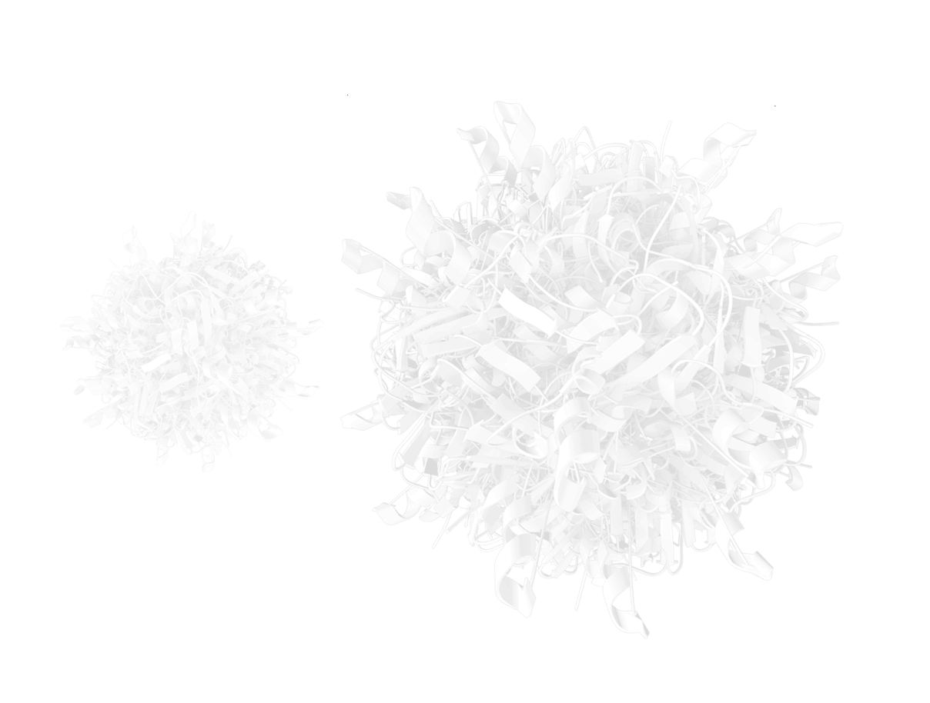
Wet Lab Accelerator
Tech Preview
Visually design automated, remote wet lab protocols
Repeatable + reproducible experiments
Data alongside protocol
Notes:
Wet Lab Accelerator (WLA) is a freely available web application supplementing existing cloud labs, which empowers researchers and comprises a graphical interface for designing, exploring, and distributing protocols and the data they generate.

Slide 15
Wet Lab Accelerator
Tech Preview
Sharable + Reusable
Parameterization
In-line ordering
Aid debugging + iteration
Notes:
- Also aids collaboration - papers have increasing number of authors
- Future of publication
Protocols inherently sharable and reusable, high-throughput and parallelized.
potentially open-source or crowd-sourced. open-source medicine?
- large, consistent, normalized, and schematized datasets -> facilitate experimental design and yield interesting results themselves.

Slide 16
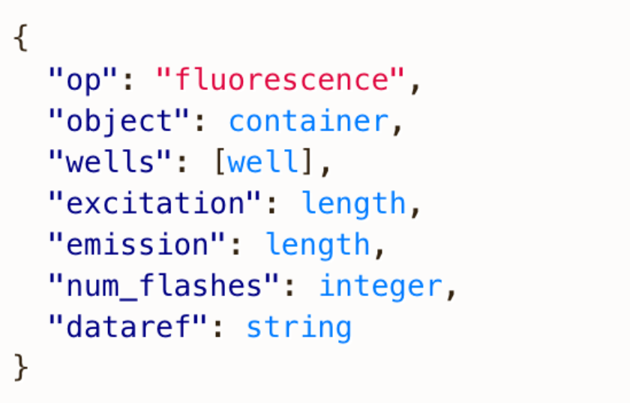
{
"refs": {
"ecoli_container": {
"id": "ct17p6qptuu5de",
"store": {
"where": "cold_20"
}
},
"plasmid_container": {
"id": "ct17p6qcyguqgs",
"store": {
"where": "cold_20"
}
},
"growth_plate": {
"new": "96-flat",
"store": {
"where": "cold_20"
}
},
"transform_tube": {
"new": "micro-1.5",
"store": {
"where": "cold_20"
}
},
"ecoli_control": {
"id": "ct17pd4w85bted",
"store": {
"where": "cold_20"
}
}
},
"instructions": [
{
"op": "incubate",
"object": "ecoli_container",
"where": "ambient",
"duration": "20:minute",
"shaking": false
},
{
"op": "incubate",
"object": "ecoli_control",
"where": "ambient",
"duration": "20:minute",
"shaking": false
}
Wet Lab Accelerator
Autoprotocol
Transcriptic
Notes:
worth mentioning because currently UI largely built around abstraction
Goal of supporting standardization
Precise, unambiguous, readable
JSON, python library
protocols reduce to operations - describe operations. atomic instructions. e.g. liquid handling, photometry reading, etc.

Slide 17
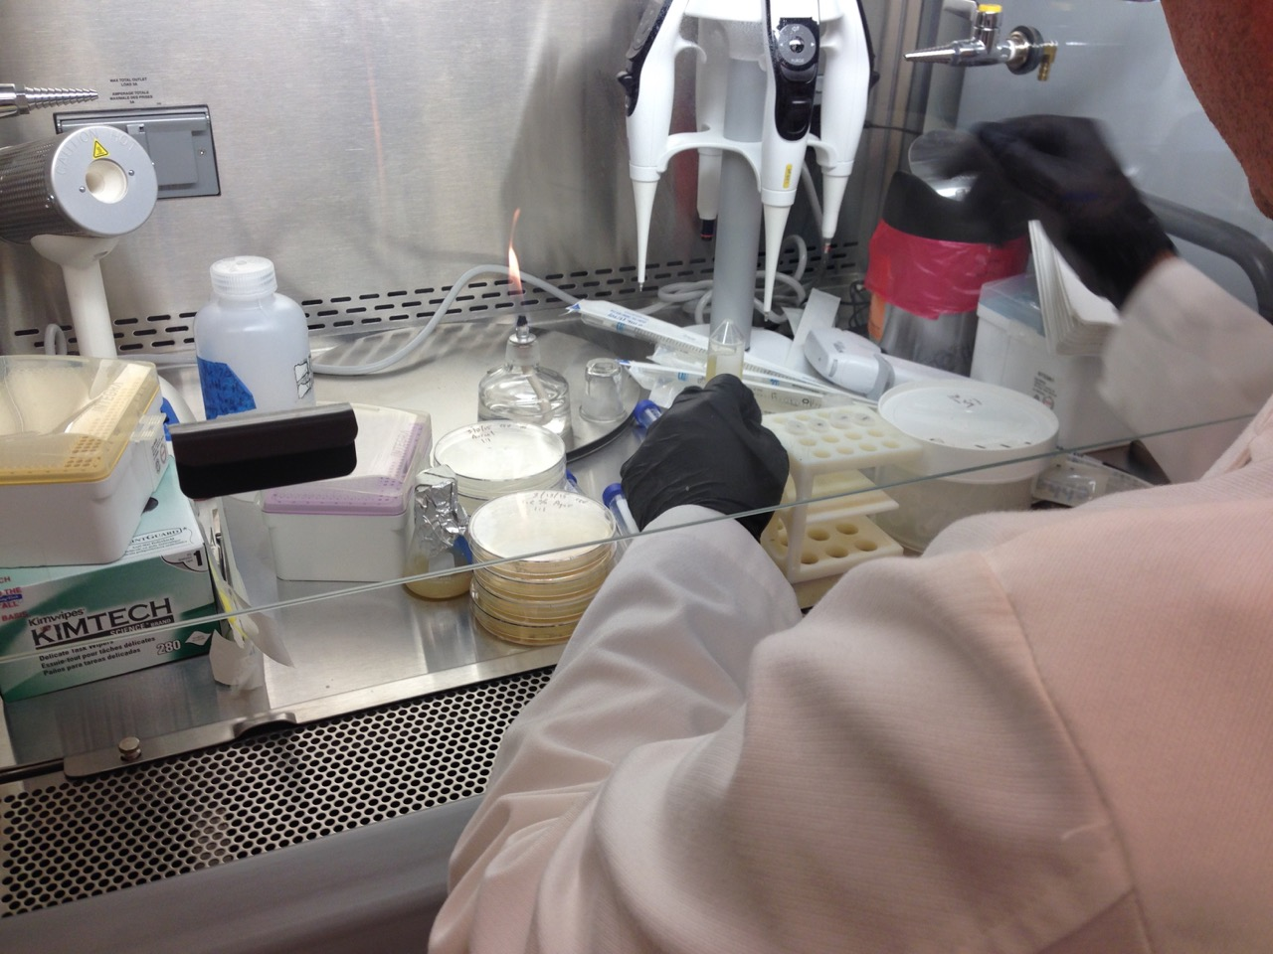
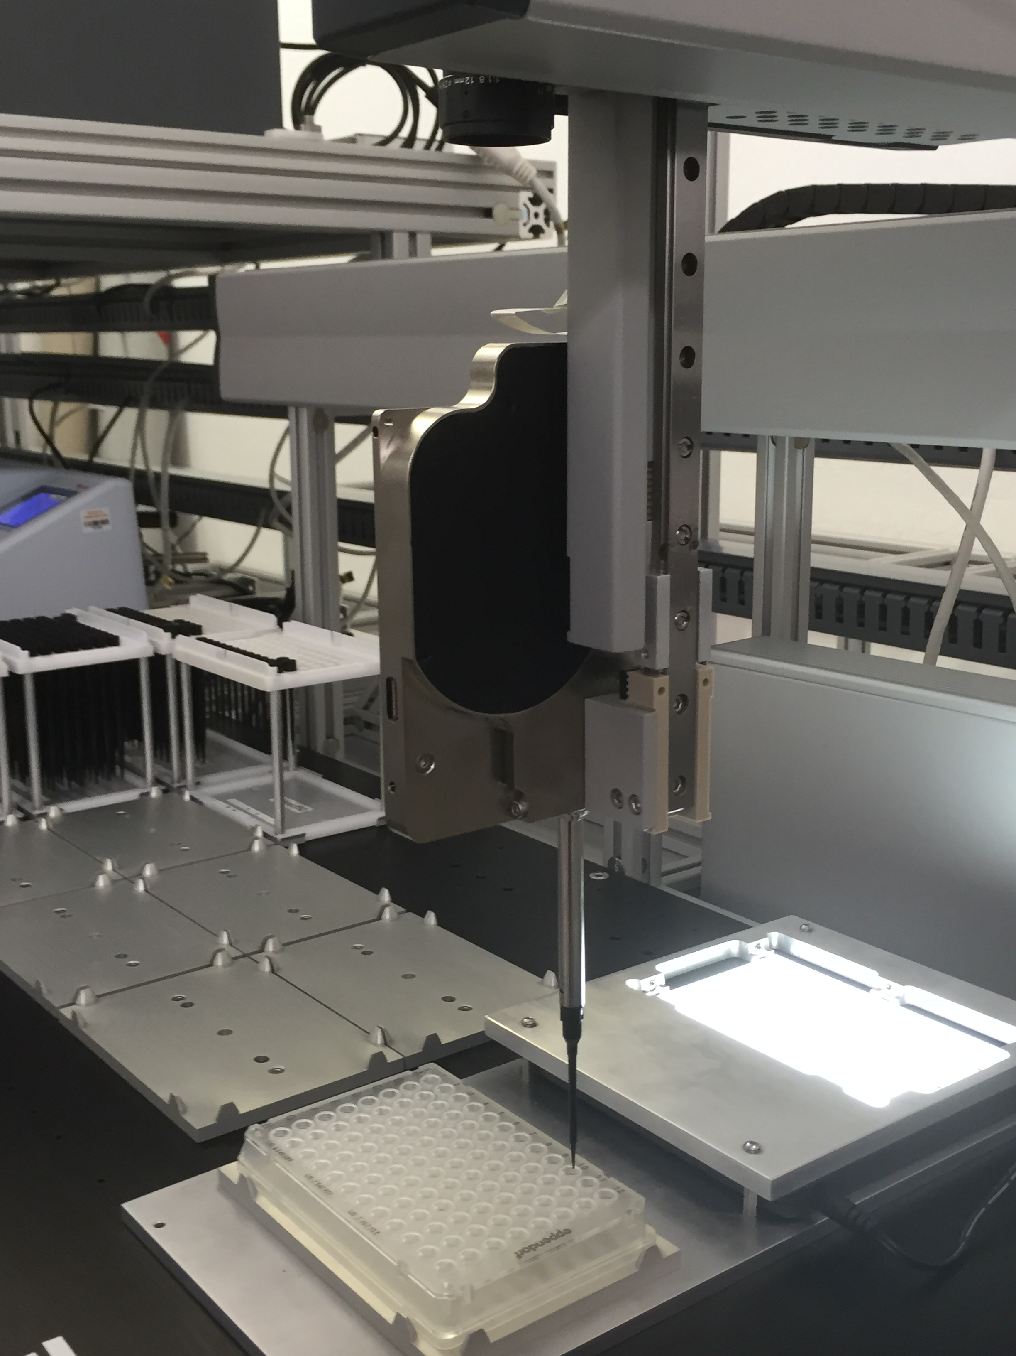
Transcriptic
Notes:
have a lab in our office
migrating experiments to the cloud
Non-trivial - but reusable
mention aaron berliner! yay aaron!

Slide 18
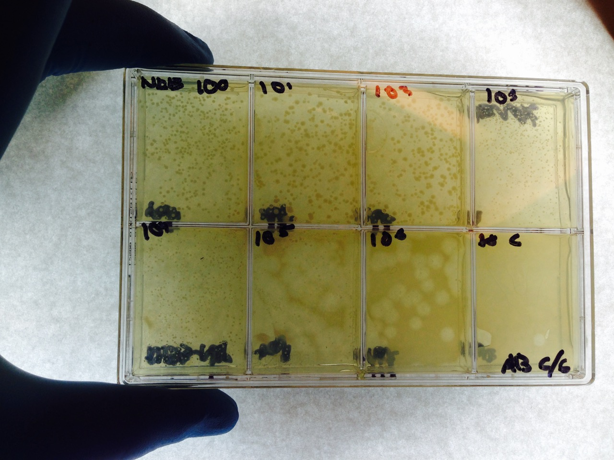
Notes:
In the process of moving to automation, running experiments this month.
also want to run experiments which are high-thoughput and verify experiments are consistent

Slide 19
Initial Release
Gallery
Timing +
Conditionals
Automated Interpretation
Synthetic Viruses
CRISPR
Vertical Integration
Experimental Pipeline +
Debugging
Notes:
Facilitate the DBTL paradigm -> debugging
Requires vertical integration of synthesis, running experiments, automated testing, learning from experiments
features like publishing are widely applicable, drive platform development.
- integration of apps
aids publishing
aid ecosystem of connected tools, which has been long-standing mission of group

Slide 20
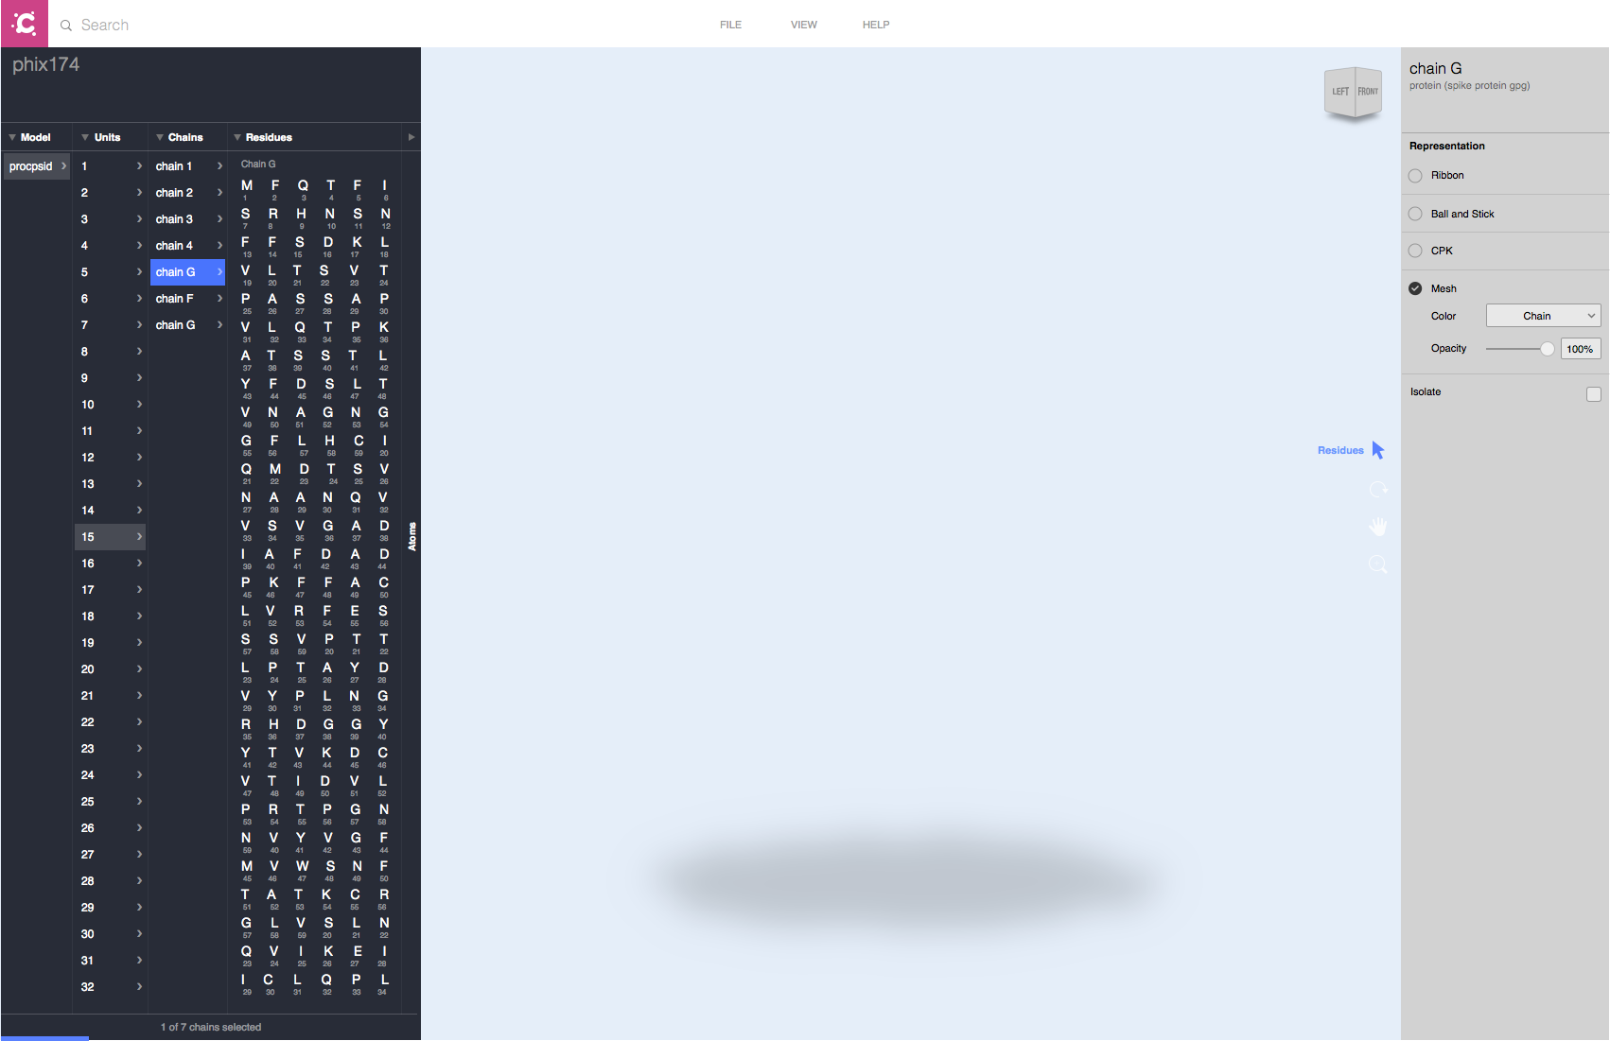
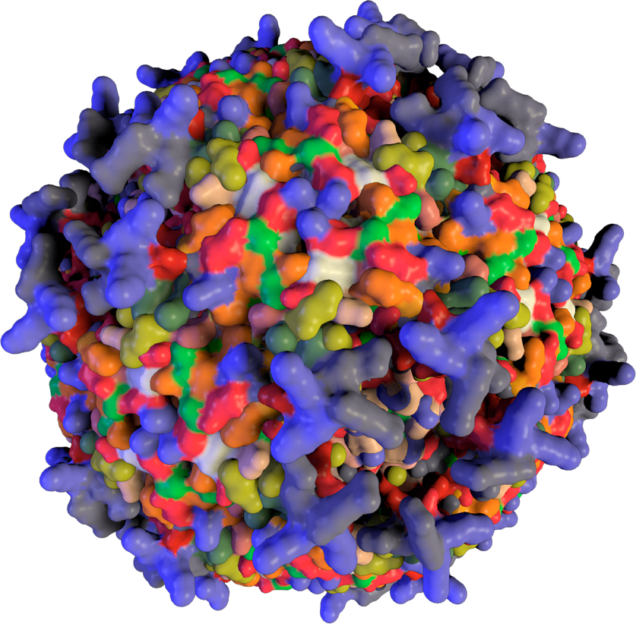
Notes:
Goal is to move away from experiments in the lab, to experiments in coffee shop from your computer. want integrate whole process + ordering etc.
In context of self-regulating field, worth addressing biosecurity.
no firm legislation. been working with FBI.
synthesis companies won’t let you synthesize DNA which looks dangerous.
can ship to transcriptic, can’t shop back to you unless accredited institution.

Slide 21
Demo
Notes:
operations
go through transformation protocol, describe relevant operations briefly
notion of containers used throughout to keep tangible visual representation
write protocol once, share, anyone can use it
in run data - address how finicky biological data is
high-throughput. need for automated testing + controls
can write experiment in 10 minutes, get results in two days
labor is order of magnitude cheaper - show run dialog

Slide 22
Technologies
Wet Lab Accelerator : Web application
AngularJS, D3
Molecular Visualization : WebGL application
LMV
Platform
Docker, Haxe, Amazon cloud computation

